Slide 1
Will the salary contribute to the team’s Win?
( feat : Relation with Salary and Winning )

Slide 2
Yes It’s Sports statistics
Movie : ”Money Ball”
→ It’s true Story!
02' Oakland Athletics original weak Team
: Because of Small Market Team
Using team sports statistics (on-base percentage) to bring a new trend to the MLB with low-cost, high-performance players
Sports statistics are actively used since this point

Slide 3
How much do you know about NBA?
A short summary of NBA
: base on NBA 17-18 Season
1) Players
: 5 vs 5 on floor
2) 12 minute per Quarter
: Total 48 min / G
3) 82 Games per Team
4) Total Teams : 30 Teams
: Eastern 15 vs Western 15
5) After Regular Season , Play-off

Slide 4
Web Scrap Site
NBA official Stats
: https://stats.nba.com
Win Share Stats
: https://www.basketball-reference.com
Player’s Salary Info
: https://hoopshype.com/salaries/players/2017-2018

Slide 5
17-18 Team Record ( Team with Salary Cap )
Salary Cap is Total Sum of Player Salary
→ The Team Rank does not depend on the salary!

Slide 6
Salary Histogram
→ The Top Ranked Players occupies most of the salary.
Average of Player’s Salary

Slide 7
Salary Scatter ( Player / Team )
The higher Rank,
The higher cluster of Salary
Low-efficiency player

Slide 8
1. Correlation between Salary and Playing Time
The higher the salary, the higher the playing time.

Slide 9
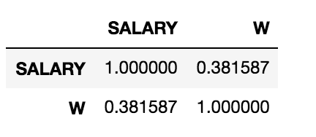
2. Correlation between Salary and WIN
→ The high salary does not contribute to winning the team.

Slide 10
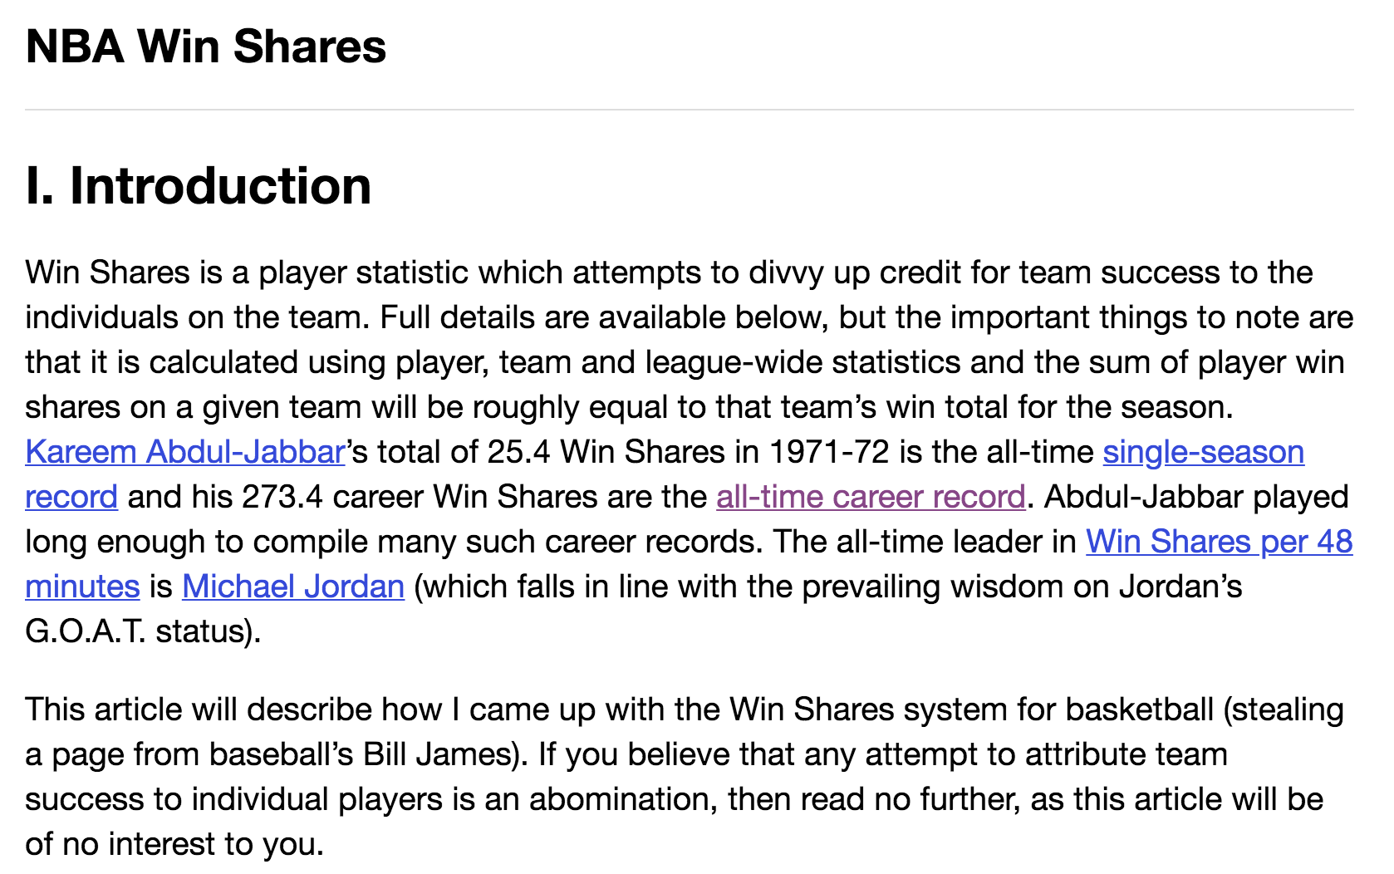
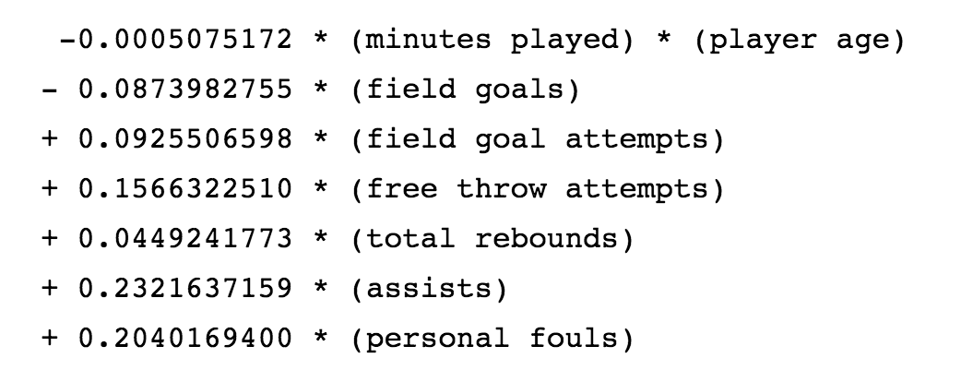
Win Share
: One of the way to measure how you contribute to team win
Ex) one of offensive win share formula
offensive WS (1) + defensive WS (2) = Win Share

Slide 11
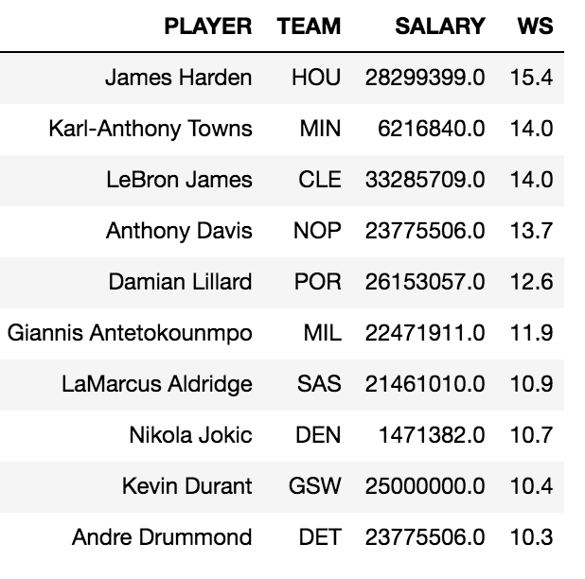
WIN Share Top10 NBA 17-18 Season
James Harden WS : 15.4
: MVP!!!
- All player in the table is Super Star

Slide 12
Relation with WS and Salary
Low-efficiency player

Slide 13
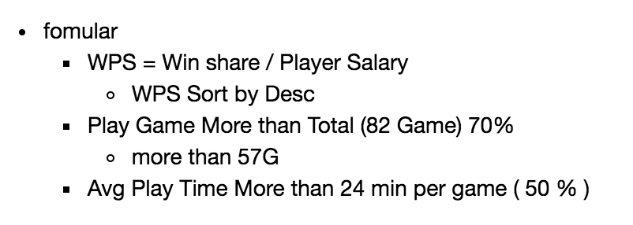
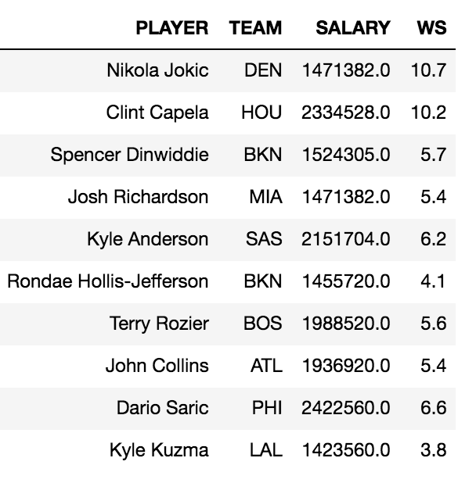
Let's Find Most cost effective Player
Nikola Jokic [ Denver Nuggets ]

Slide 14
Let's Find Most cost effective Player
High-efficiency player

Slide 15
Conclusion & Limitation
1. Many investments can't win,
but the winning team has made a lot of investment.
2. A salary raised by scarcity
→ position or situation
3. A record that can not be checked
( ex) Screen Play , Spacing )
4. The higher the Win Share, the greater the scarcity.
→ Simple correlation and Avg has limitation

Slide 16
Thank you!
Let’s Enjoy New NBA Season!

